Slide 1
Vertical Fish Farming
Xu Sheng

Slide 2
Project Objective
Save manpower
Enhance efficiency

Slide 3
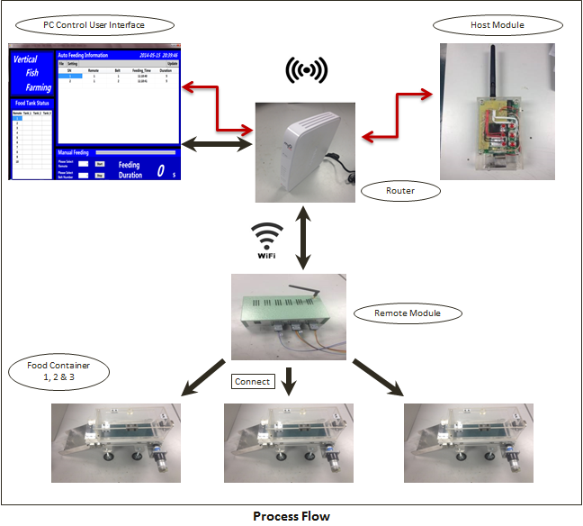
Flow Chart of the system

Slide 4
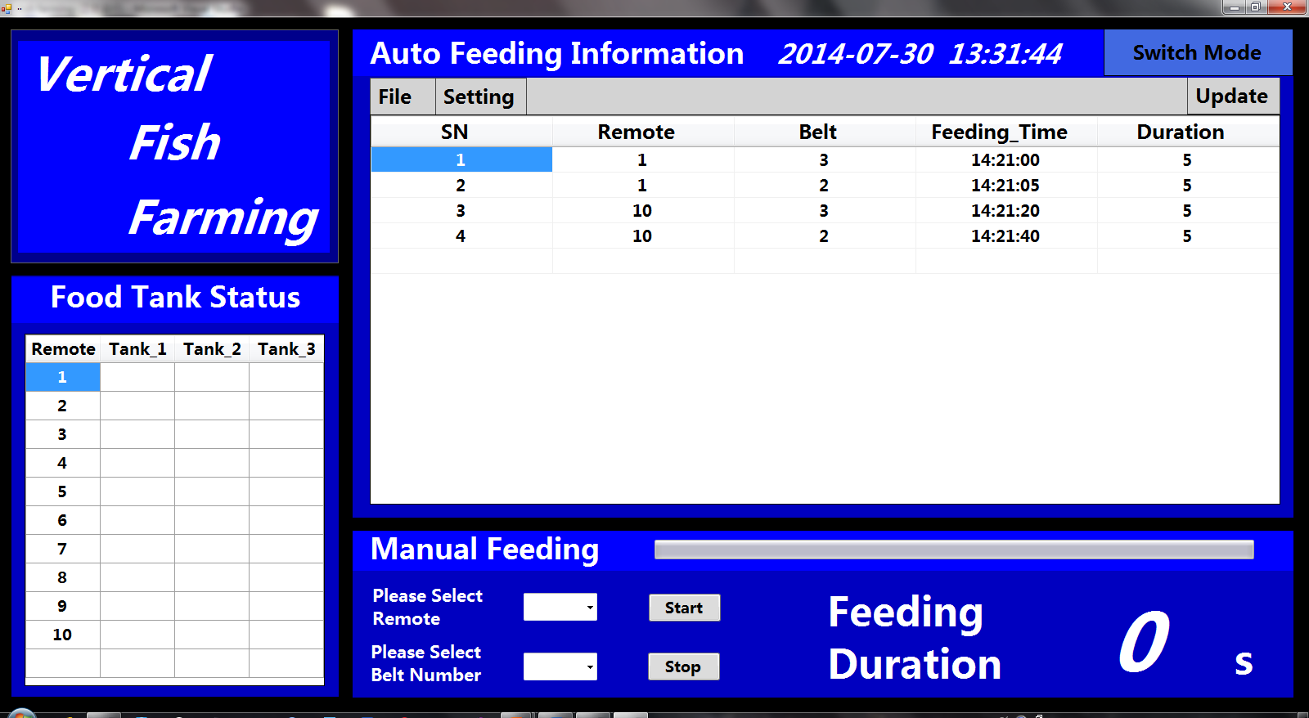
PC control

Slide 5
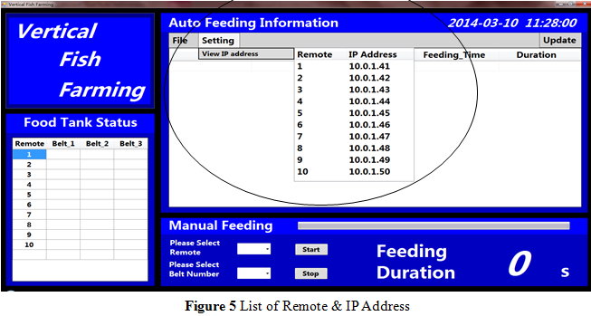
Auto Feeding

Slide 6
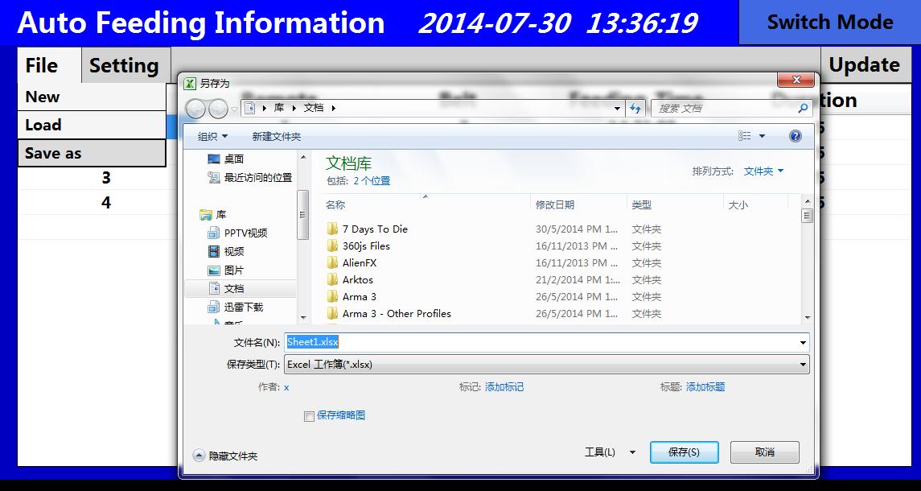
Import & Export

Slide 7
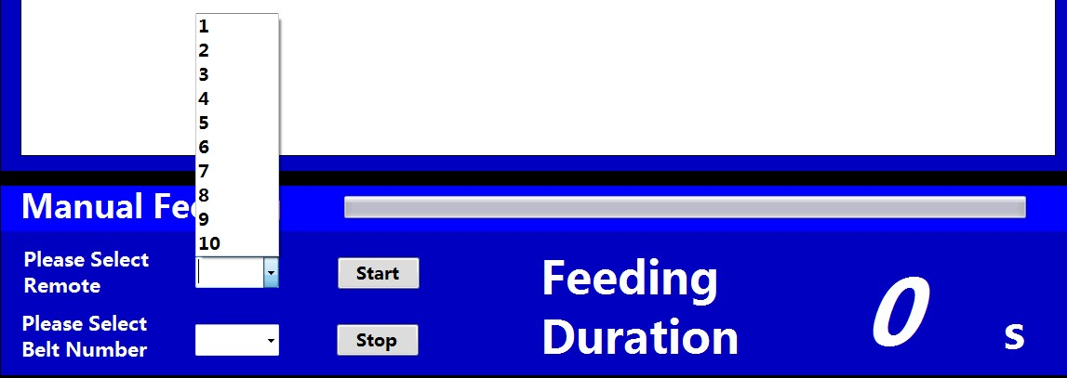
Manual Control

Slide 8
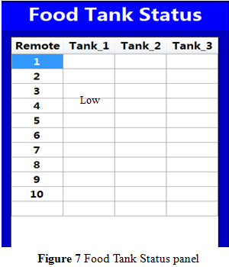
Food Tank Status

Slide 9
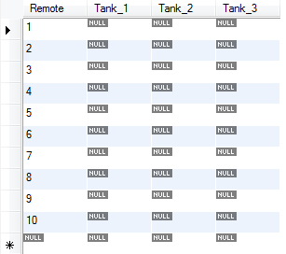
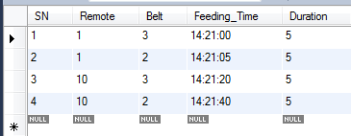
Mysql Database
Auto Feeding
Food Tank Status

Slide 10
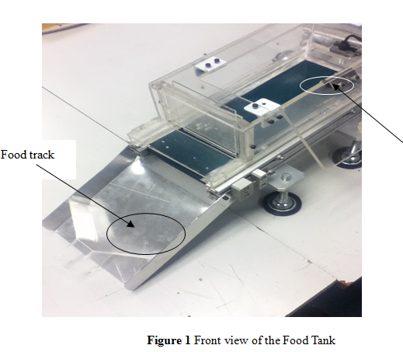

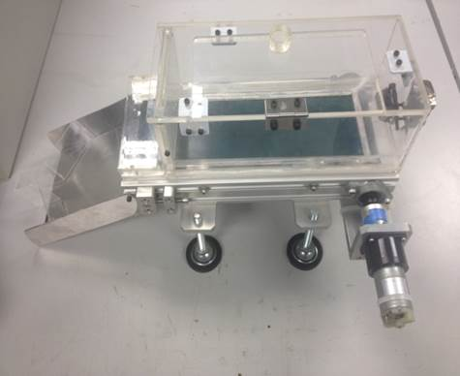
Hardware Food tank

Slide 11
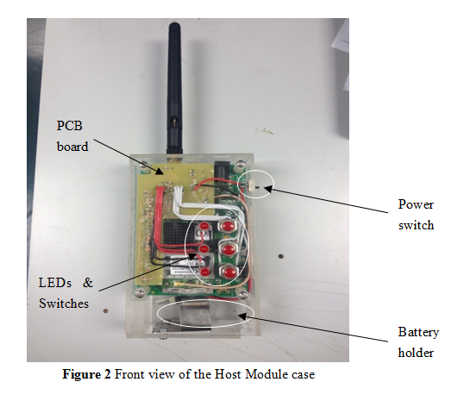
Host Module

Slide 12
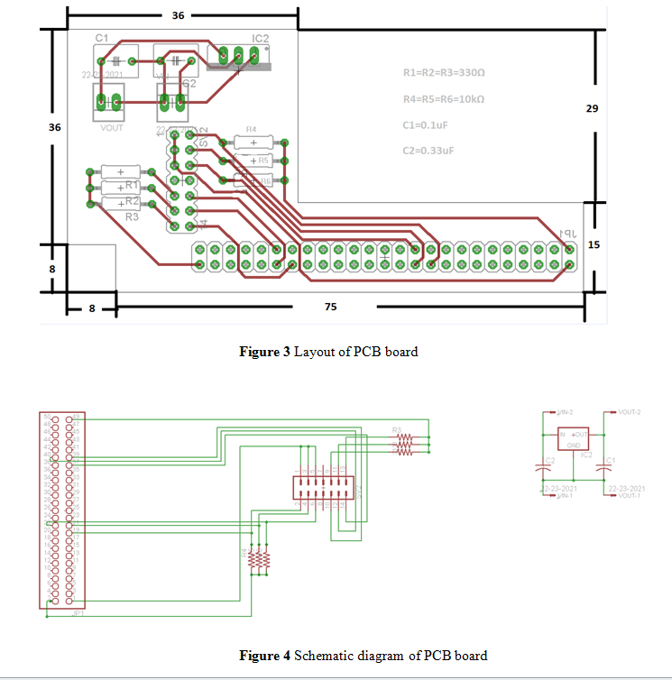
PCB of Host Module

Slide 13
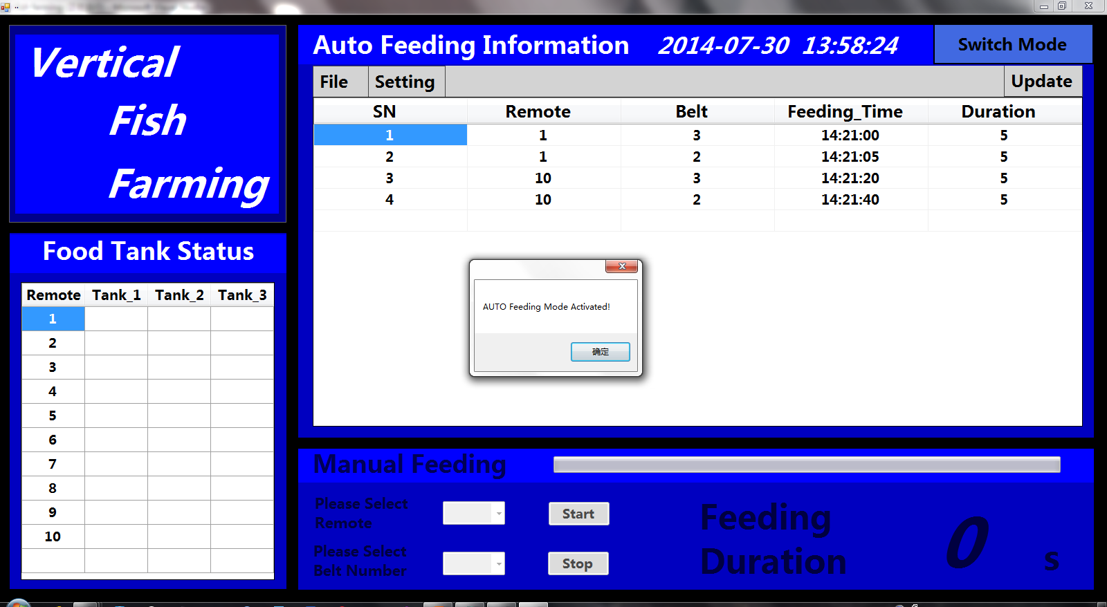
Mode Switch

Slide 14
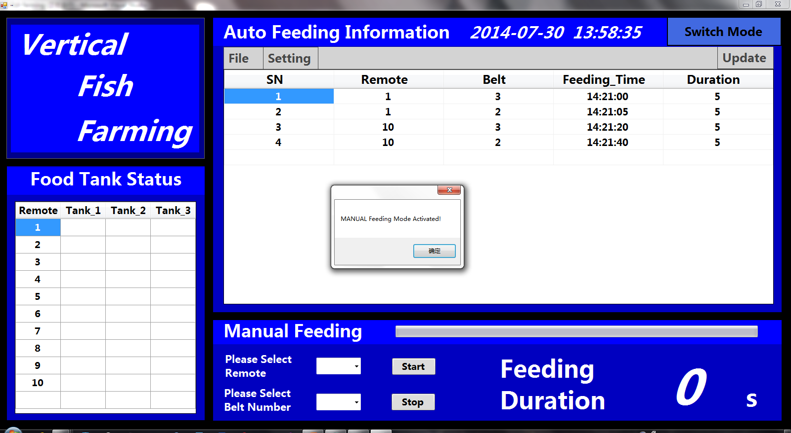
Switch to manual feeding

